Slide 1
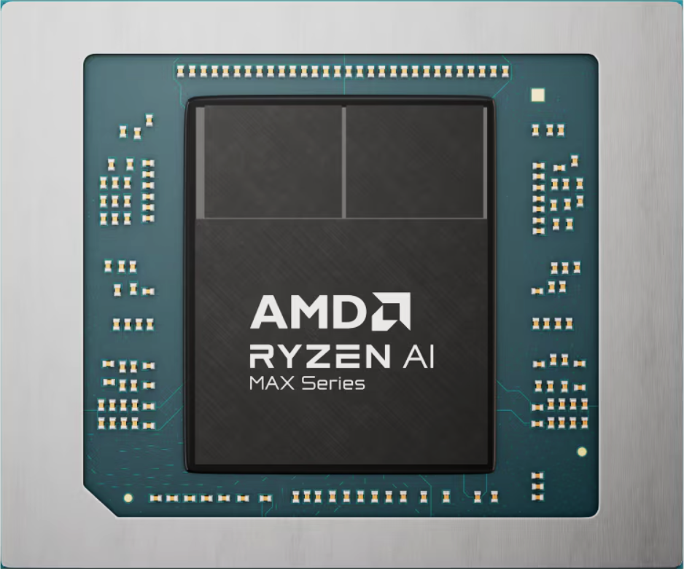
AMD Ryzen™ Al Max+ 395
林偉翔01257174 許能翔01257176

Slide 2
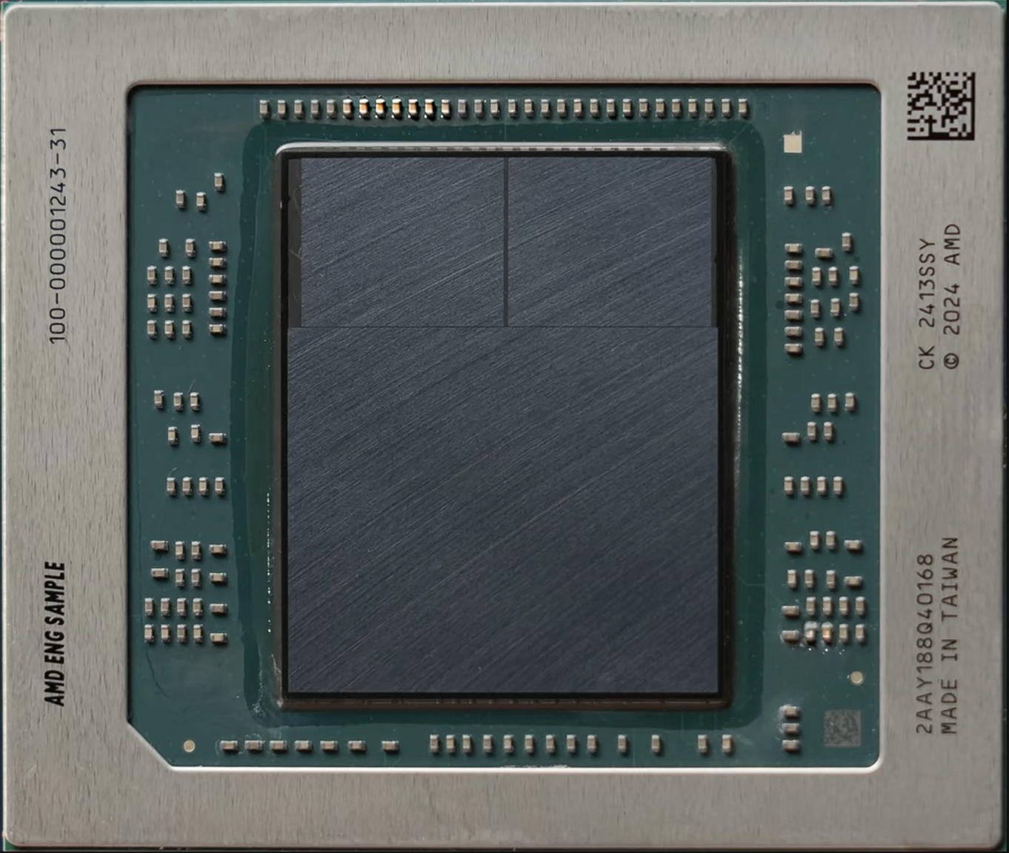

Slide 3
CCD #0
CCD #1
I/O Die

Slide 4
CCD #0
CCD #1
I/O Die

Slide 5
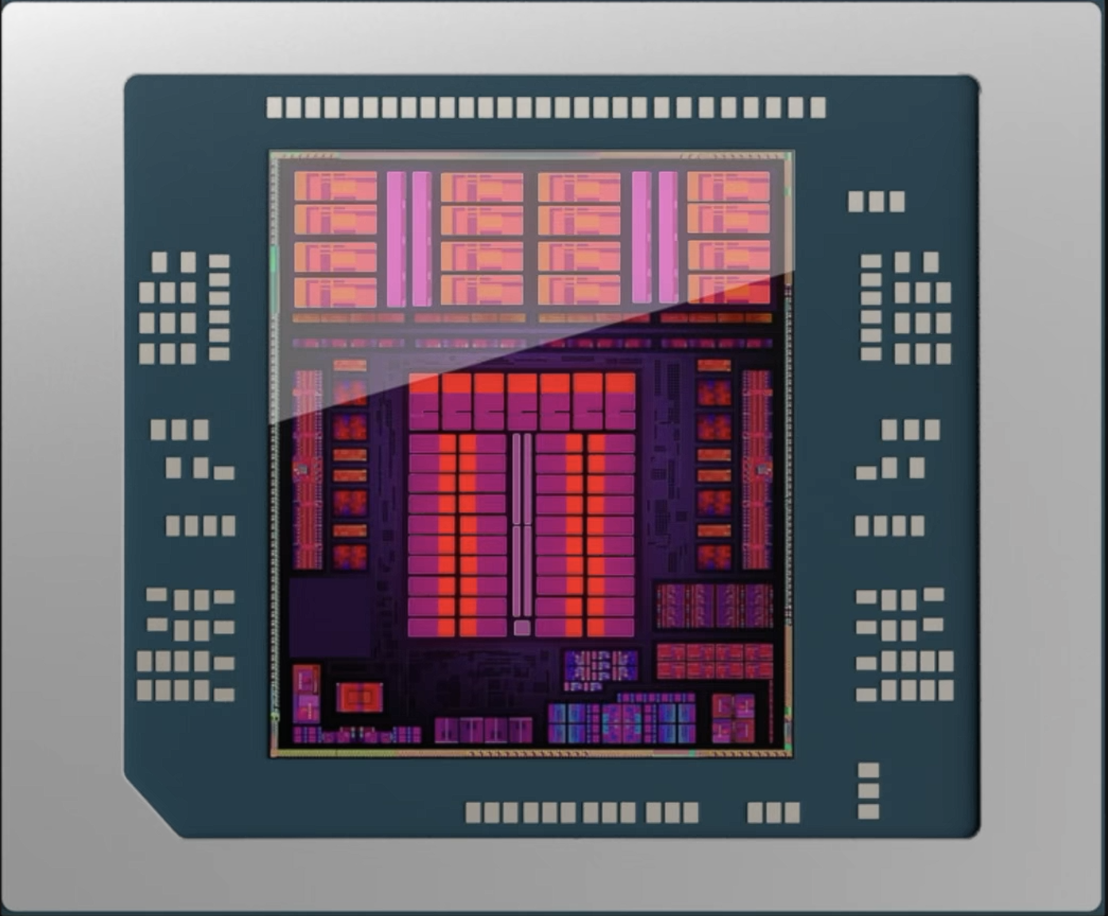

Slide 7
Technology nodes comparison

Slide 8
TSMC quotes that N4P further improves N4's performance by around 6%.
N4P
N5, N4P will deliver an 11% performance boost, a 22% improvement in power efficiency, and a 6% improvement in transistor density.
N4
N5
https://en.wikichip.org/wiki/5_nm_lithography_process
https://www.tomshardware.com/news/tsmc-announces-n4p-process-a-refined-n4-chip-node

Slide 9
ZEN5
About ‘Zen5’

Slide 10
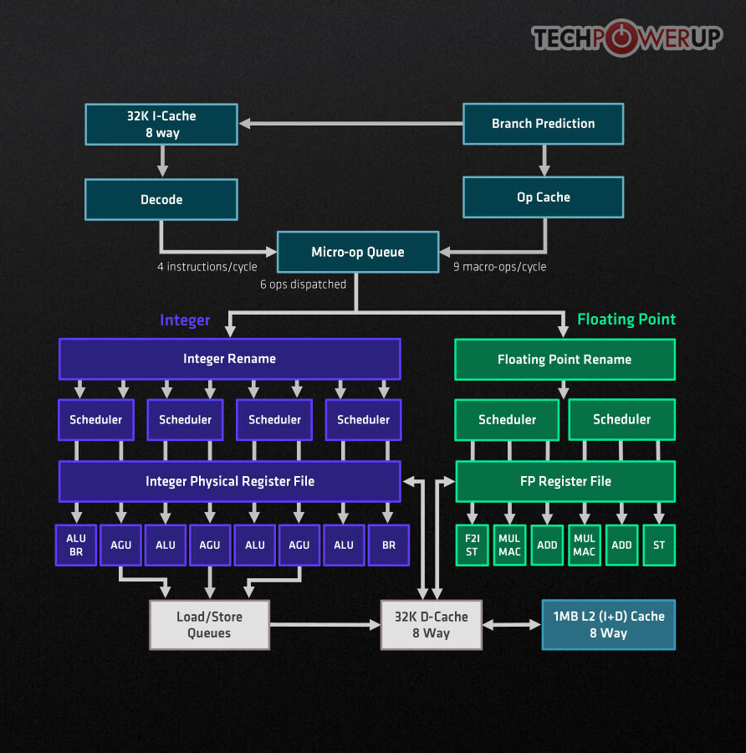
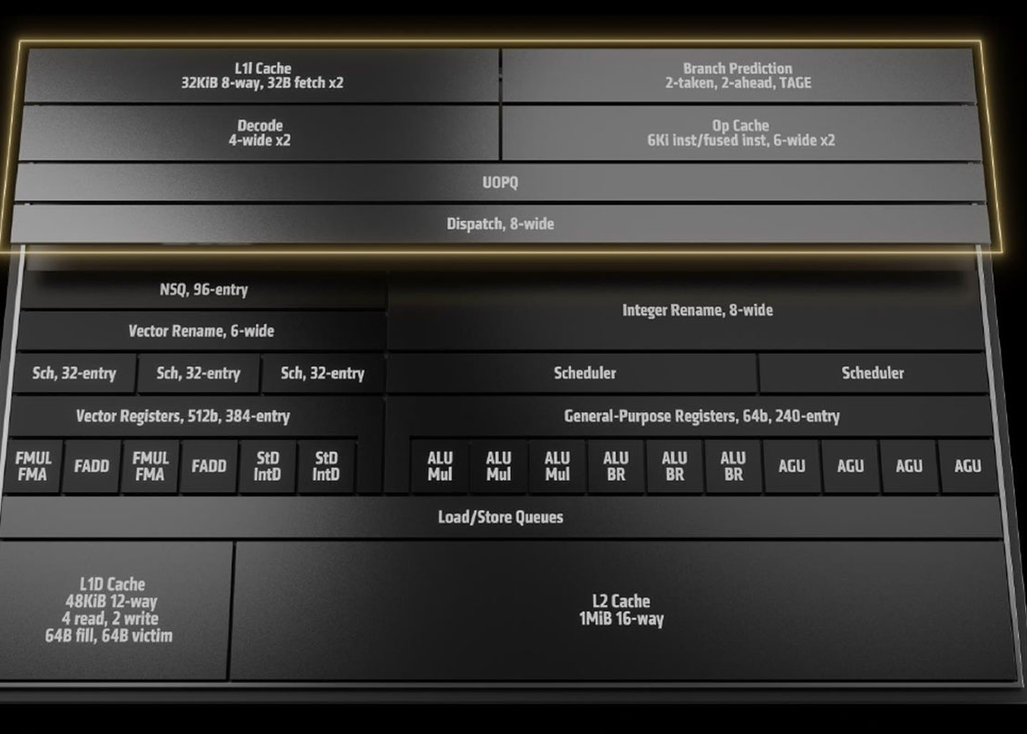

Slide 11
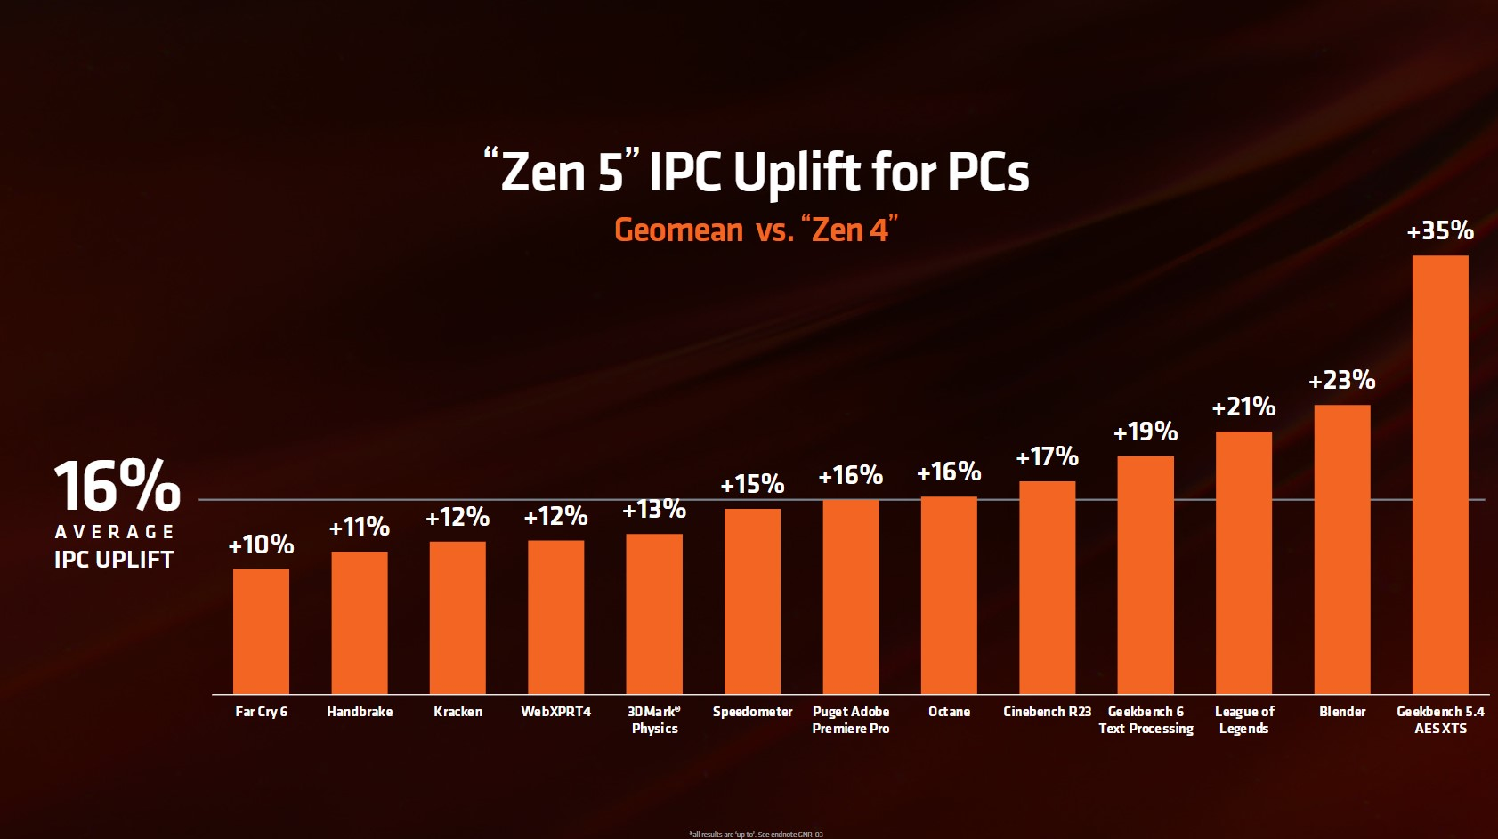

Slide 12
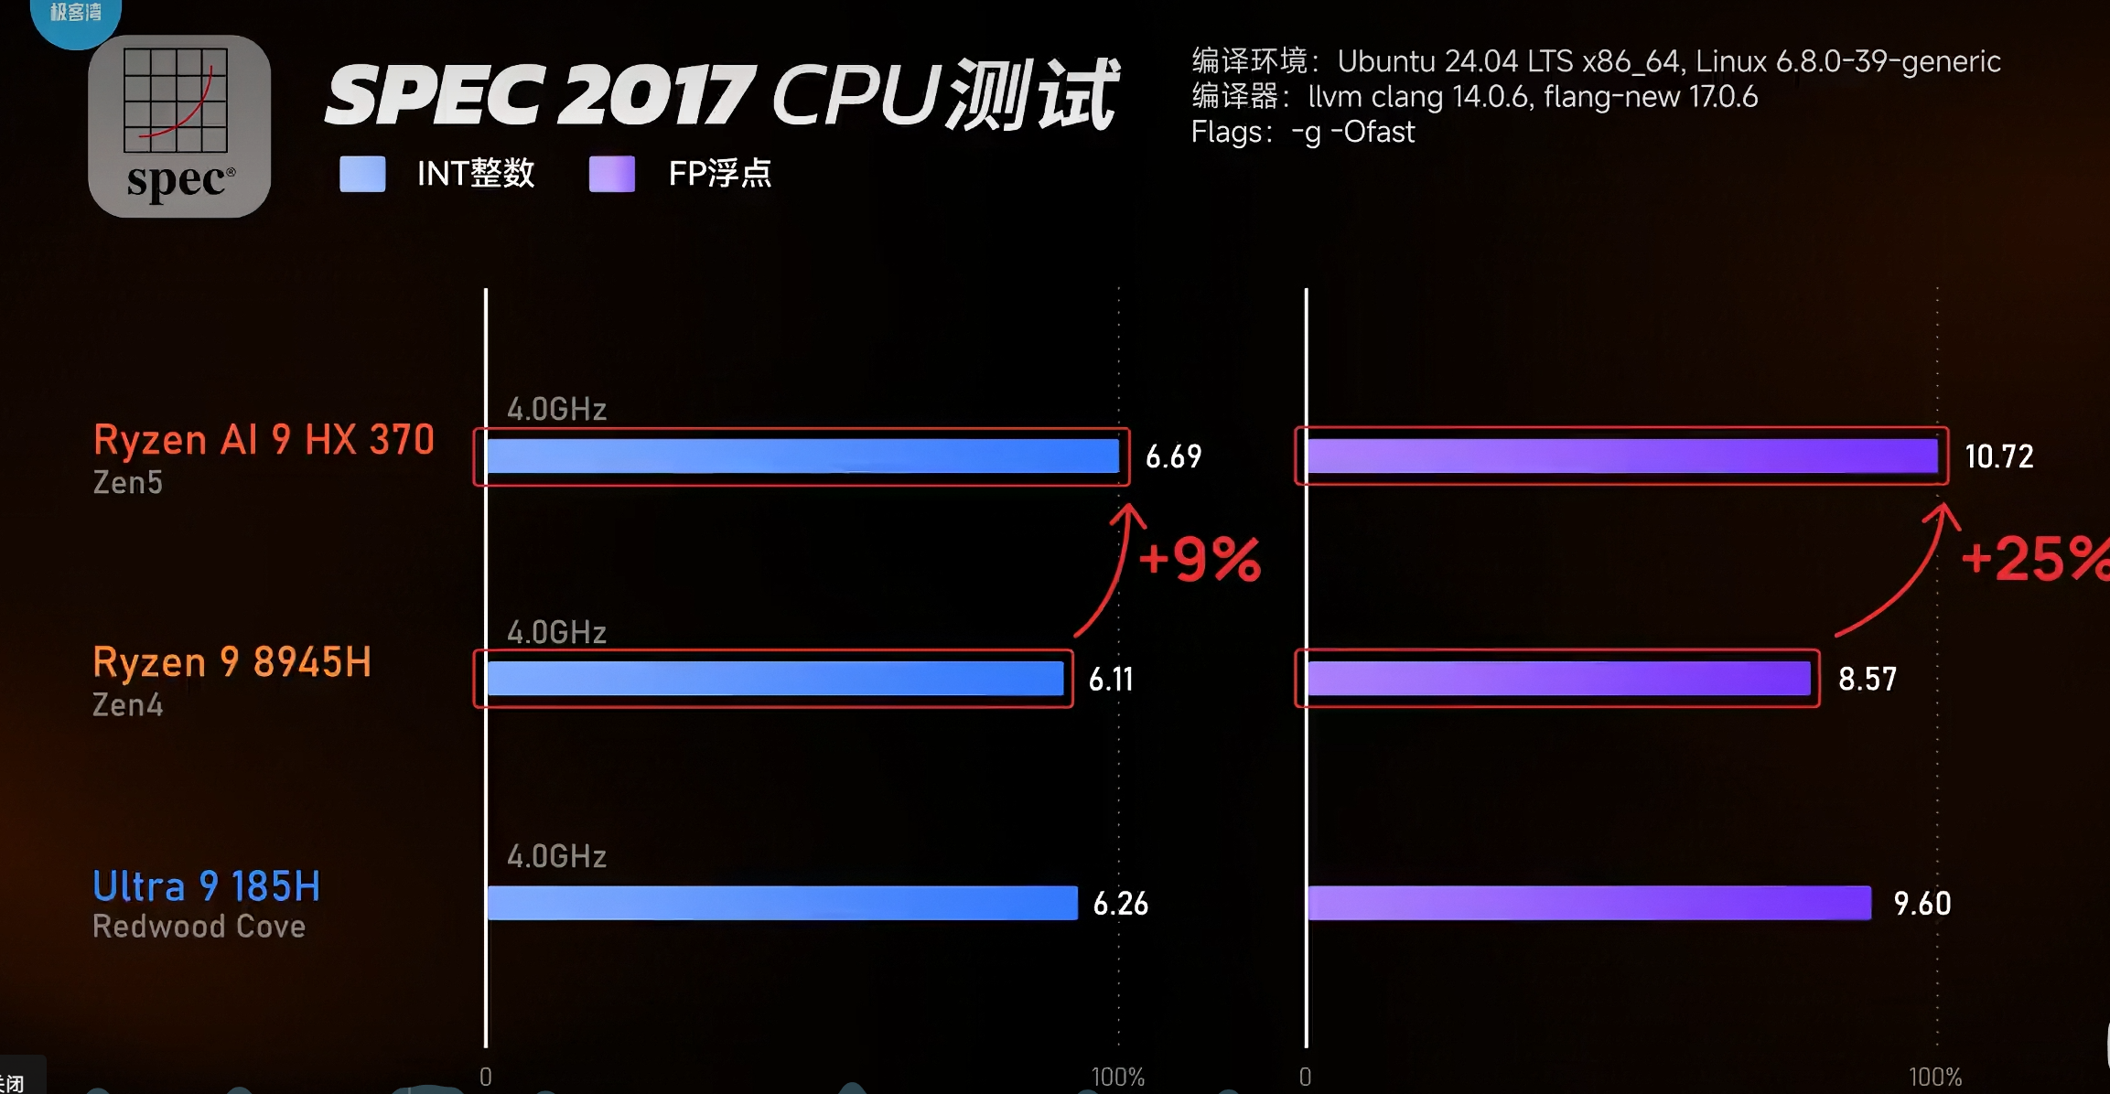

Slide 13
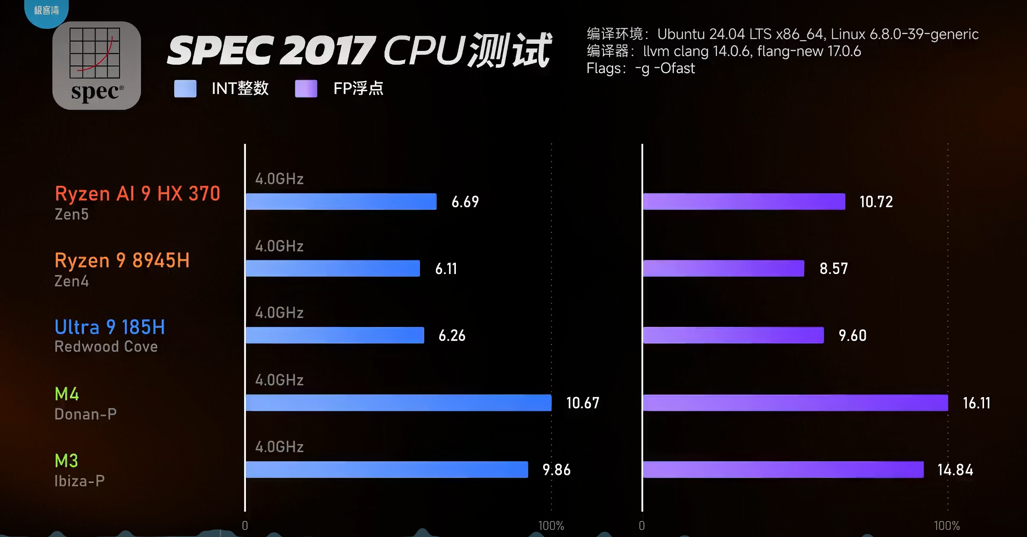

Slide 14
Unified Memory Architecture
统一内存架构

Slide 15
电子斗蛐蛐

Slide 16




3D Mark Timespy
GPU在DX12 图形API分辨率为2K下的理论跑分
*以TDP为80W的 “Radeon 8060” 为基准。
*分数越高越好。
Radeon 8060s
9882
RDNA 3.5
80W
100%
Radeon 8060s
2526
15W
25.56%
RDNA 3.5
Radeon 780M
2787
15W
28.20%
RDNA 3
Radeon 890M
3333
RDNA 3.5
15W
33.77%
RTX 3060 Laptop
8278
Ampere
115W
83.77%
RTX 4060 Laptop
10404
Ada Lovelace
115W
105.28%
RTX 5060 Laptop
12040
Blackwell
115W
121.84%
Arc 140T Mobile
3787
Xe-LPG+
35W
38.32%
0%
100%
120%

Slide 17


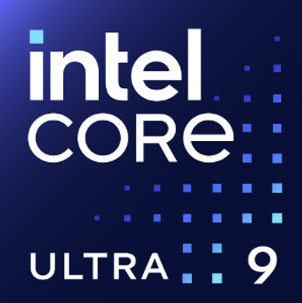
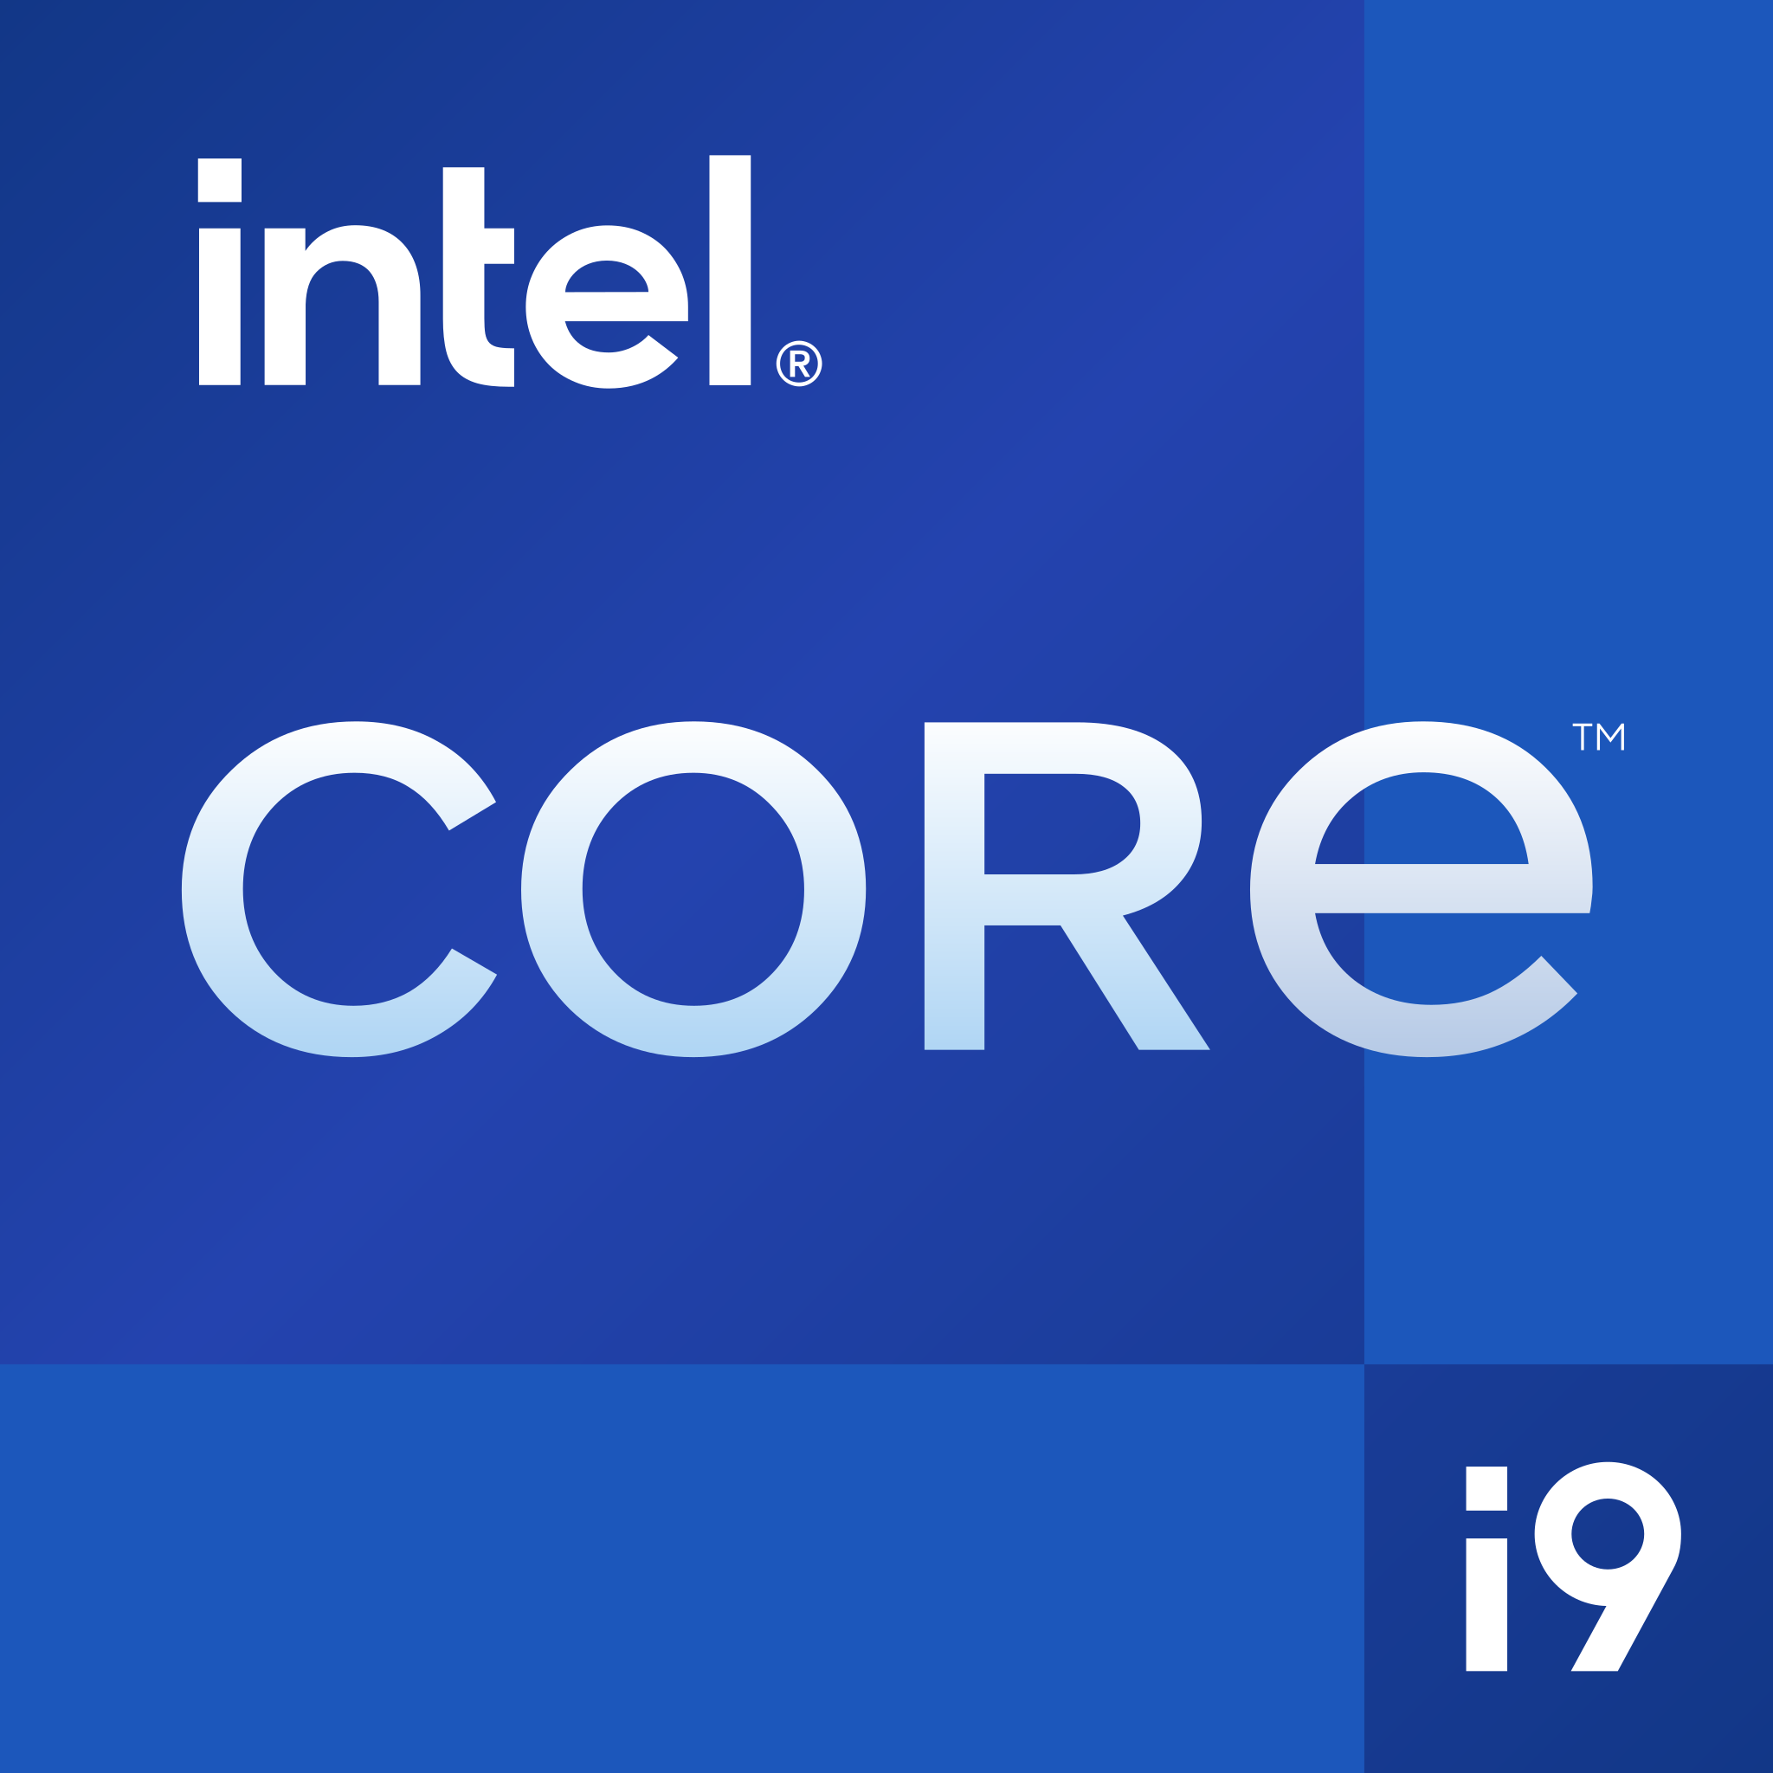
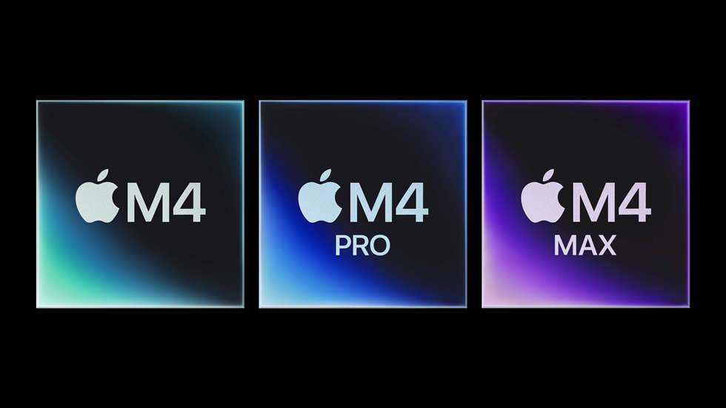
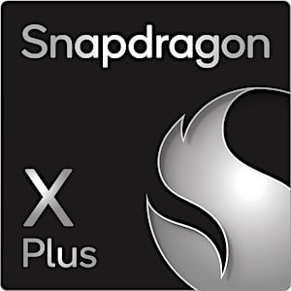
Cinebench R23
Multi Core多核分数
*N3B为TSMC第一代3nm技术节点，N3E为TSMC第二代3nm技术节点，N3P为TSMC第三代3nm技术节点。
*Ryzen AI Max+ 395为基准。
*分数越高越好。
Ryzen AI Max+ 395
33960
120W
100%
Zen5
TSMC N4P(4nm)
Ryzen 9 9955HX3D
38400
101W
113.07%
Zen5
TSMC N4P(4nm)
Core Ultra 9 285HX
38963
Lion Cove(P-cores) Skymont(E-cores)
160W
114.73%
TSMC N3B(3nm)
Core I9 14900HX
33619
Raptor Cove(P-cores) Gracemont(E-cores)
157W
98.99%
Intel7(10nm)
Apple M4 (10-core)
13471
40W
39.67%
Donan(P-cores) Brave(E-cores)
TSMC N3E(3nm)
Apple M4 Pro
23105
46W
68.04%
Donan(P-cores) Brave(E-cores)
TSMC N3E(3nm)
Apple M4 Max
27399
70W
80.68%
Donan(P-cores) Brave(E-cores)
TSMC N3E(3nm)
Qualcomm Snapdragon X2 Elite Extreme (X2E-96-100)
24082
96W
70.91%
3rd Gen QualcommOryon CPU
TSMC N3P(3nm)
0%
100%
120%

Slide 18
Cinebench R23
Single Core单核分数
*N3B为TSMC第一代3nm技术节点，N3E为TSMC第二代3nm技术节点，N3P为TSMC第三代3nm技术节点。
*Ryzen AI Max+ 395为基准。
*分数越高越好。
Ryzen AI Max+ 395
2034
120W
100%
Zen5
TSMC N4P(4nm)
Ryzen 9 9955HX3D
2166
101W
113.07%
Zen5
TSMC N4P(4nm)
Core Ultra 9 285HX
2244
Lion Cove(P-cores) Skymont(E-cores)
160W
114.73%
TSMC N3B(3nm)
Core I9 14900HX
2183
Raptor Cove(P-cores) Gracemont(E-cores)
157W
98.99%
Intel7(10nm)
Apple M4 (10-core)
2159
40W
39.67%
Donan(P-cores) Brave(E-cores)
TSMC N3E(3nm)
Apple M4 Pro
2276
46W
68.04%
Donan(P-cores) Brave(E-cores)
TSMC N3E(3nm)
Apple M4 Max
2281
70W
80.68%
Donan(P-cores) Brave(E-cores)
TSMC N3E(3nm)
Qualcomm Snapdragon X2 Elite Extreme (X2E-96-100)
2020
96W
70.91%
3rd Gen QualcommOryon CPU
TSMC N3P(3nm)
0%
100%
120%

Slide 19
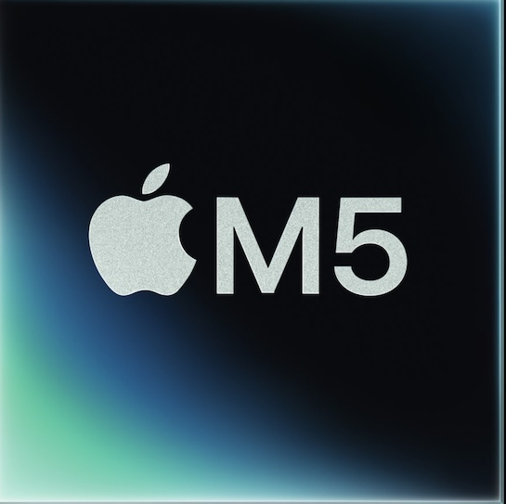
Cinebench R23
Single Core单核分数
*N3B为TSMC第一代3nm技术节点，N3E为TSMC第二代3nm技术节点，N3P为TSMC第三代3nm技术节点。
*Ryzen AI Max+ 395为基准。
*分数越高越好。
Ryzen AI Max+ 395
2034
120W
100%
Zen5
TSMC N4P(4nm)
Ryzen 9 9955HX3D
2166
101W
113.07%
Zen5
TSMC N4P(4nm)
Core Ultra 9 285HX
2244
Lion Cove(P-cores) Skymont(E-cores)
160W
114.73%
TSMC N3B(3nm)
Core I9 14900HX
2183
Raptor Cove(P-cores) Gracemont(E-cores)
157W
98.99%
Intel7(10nm)
Apple M4 (10-core)
2159
40W
39.67%
Donan(P-cores) Brave(E-cores)
TSMC N3E(3nm)
Apple M4 Pro
2276
46W
68.04%
Donan(P-cores) Brave(E-cores)
TSMC N3E(3nm)
Apple M4 Max
2281
70W
80.68%
Donan(P-cores) Brave(E-cores)
TSMC N3E(3nm)
Qualcomm Snapdragon X2 Elite Extreme (X2E-96-100)
2020
96W
70.91%
3rd Gen QualcommOryon CPU
TSMC N3P(3nm)
Apple M5 (10-core)
2569
70W
80.68%
Donan(P-cores) Brave(E-cores)
TSMC N3P(3nm)
0%
100%
120%

Slide 20
总结

Slide 21
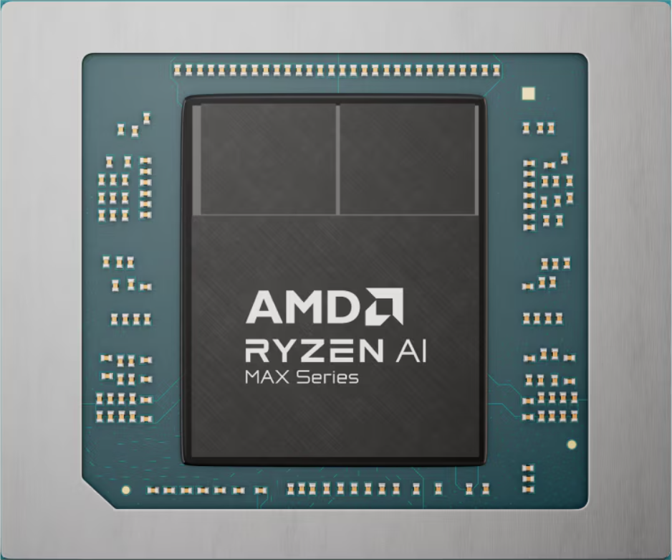
16x
Zen5 CPU
TSMC
N4P
Unified Memory Architecture
50 TOPS
NPU
LPDDR5X-8000
Up to 128GB
126 TOPS
Overall
Radeon 8060S
RDNA3.5
PBO
Ryzen
AI
40
CUs
2560
Shading unit
PCIE 4.0
55W TDP
Start from only NT$69999 ~ NT$84999

